Slide 1

Gen-AI

Slide 2
Day 1 - Python

Slide 3

Syllabus
Pre Training - History,
Training
1. Topics: Python setup, IDEs, syntax basics, elements of python programming
2. Hands-On: Install Python, set up Jupyter Notebook or VSCode, and write basic print and input commands.
Post Training - Case Study: Write a simple program for a restaurant that takes orders and prints out a receipt.

Slide 4
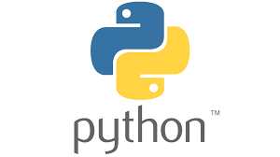
Key milestones in Python's History
1990: Python was created by Guido van Rossum.
Name Origin: Inspired by the British comedy group Monty Python.
1991: The first public release of Python.
1994: The comp.lang.python newsgroup was founded, fostering community discussions.
Open Source: Python has been open-source from its inception, promoting collaboration and transparency.
Mixes good features from Shell, Java, Perl and Scheme

Slide 5
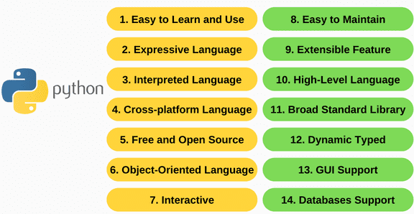
Features of Python

Slide 6
Features of Python
Easy-to-Learn: Few keywords, simple structure, and clear syntax makes it beginner-friendly.
Easy-to-Read: Code is clearly defined and visually intuitive.
Easy-to-Maintain: Simple source code with less dependencies and modest project structure.
Library: Extensive libraries that are portable and cross-platform compatible.
Interactive Mode: Supports interactive testing and debugging of code snippets.
Portable: Runs on various hardware platforms with a consistent interface.
Extendable: Allows addition of low-level modules to customize & enhance functionality.
Databases: Interfaces available for all major commercial databases.
GUI Programming: Supports GUI applications compatible with systems like Windows, Mac, and Unix.
Scalable: Offers better structure and support for large programs.
Flexible: Supports functional, structured programming, and object-oriented programming (OOP).
Adaptable: Can be used as a scripting language or compiled to byte-code for larger applications.
Dynamic: Provides high-level dynamic data types and supports dynamic type checking.
Garbage: Features automatic garbage collection for memory management.
Integration: Easily integrates with C, C++, COM, ActiveX, CORBA, and Java.

Slide 7
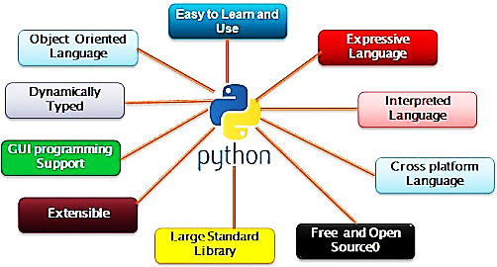
Overview of Python Language

Slide 8
Overview of Python Language
Beginner-Friendly: Simple syntax and ease of learning make it an ideal first programming language.
High-Level Language: Python is designed to be easy to read and write code.
Interpreted: Code is executed line-by-line without the need for compilation, simplifying debugging.
General-Purpose: Suitable for various software development domains such as web development, data science, automation, AI/ML, and more.
Cross-Platform: Runs seamlessly on multiple platforms like Windows, macOS, Linux, and Unix.
Flexible programming model: Supports object-oriented programming (OOP) and functional programming paradigms.
Dynamic Typing: Variables do not require explicit type declaration.
Libraries: Extensive built-in modules and libraries for various tasks like file I/O, ML, DL, Gen-AI.
Extensibility: Easily integrates with other programming languages like C, C++, and Java.
Scalability: Provides tools & structure for building both small scripts or large, complex application
Community support: Backed by a vast, active community and open-source contributions.

Slide 9
Major uses of Python Language
System utilities: Creating tools for automation and system-level tasks.
GUI’s: Building graphical interfaces with libraries like Tkinter, PyQt, and GTK.
Internet Scripts: Web scraping, API scripting, & handling internet protocols
Embedded Scripts: Extending functionality of other applications.
Database programming support: for MySQL, PostgreSQL, MongoDB, etc
Artificial Intelligence libraries: like TensorFlow, PyTorch, and scikit-learn
Image Processing: Manipulating images using tools like Pillow and OpenCV.
Generative AI: LangChain, Workflow Automation, FS development Automation, DevOps Automation,

Slide 10
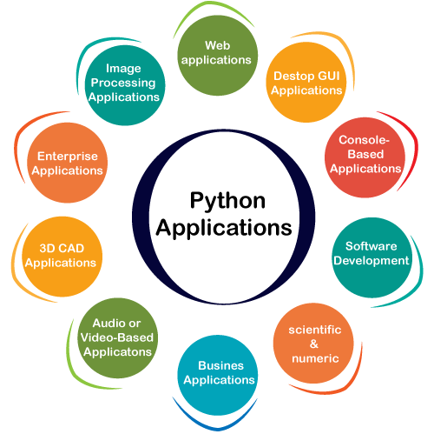
Major uses of Python Language

Slide 11
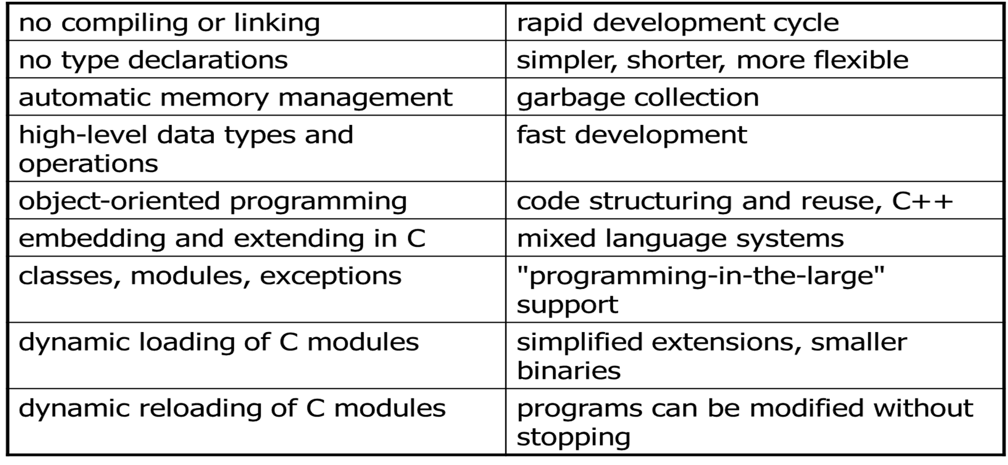
Advantages of Python

Slide 12
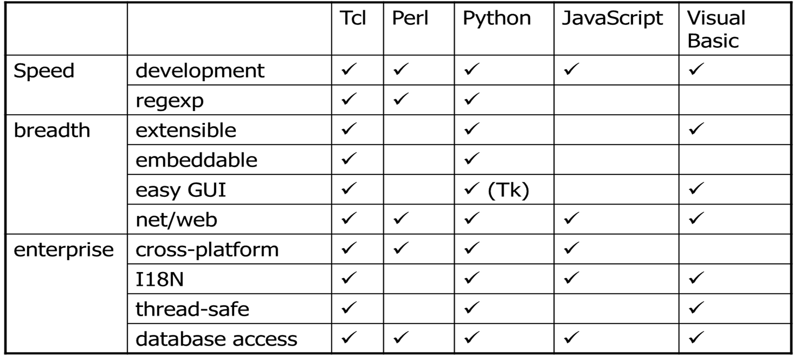
Comparison of Script Languages

Slide 13
3 Modes of Python programming-Interactive, Script, Code
Interactive Mode: Where you type code line-by-line and get immediate results in the Python interpreter. Useful for testing small snippets of code, exploring functions, and quick calculations.
Script Mode: Where you write code in a file with a ".py" extension and execute the entire script at once. Useful for writing larger programs with multiple lines of code.
Code Mode: Where you write code, encompassing both interactive and script modes. Includes elements like variables, data types, operators, functions, loops, conditional statements, etc. Useful for compiling the code to create executables.

Slide 14
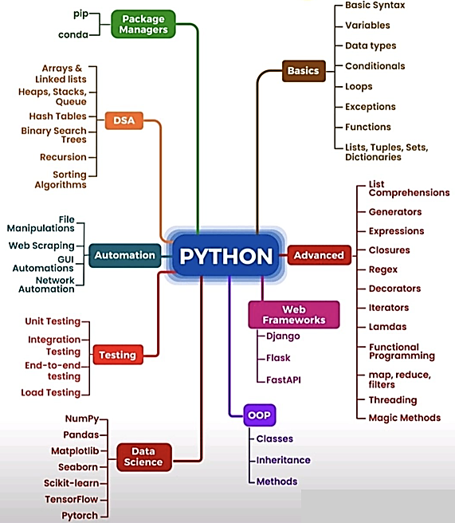
Python programming environment

Slide 15
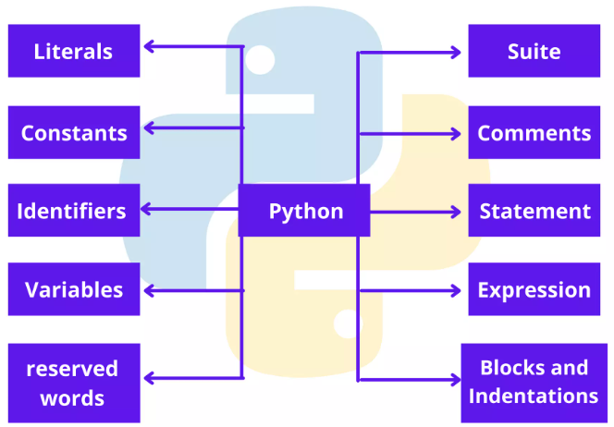
Elements of a Python program
A Python program is a sequence of definitions and commands (statements)
Commands manipulate objects
Each object is associated with a datatype
A set of operations on these values
Expressions: An operation (combination of objects and operators)

Slide 16
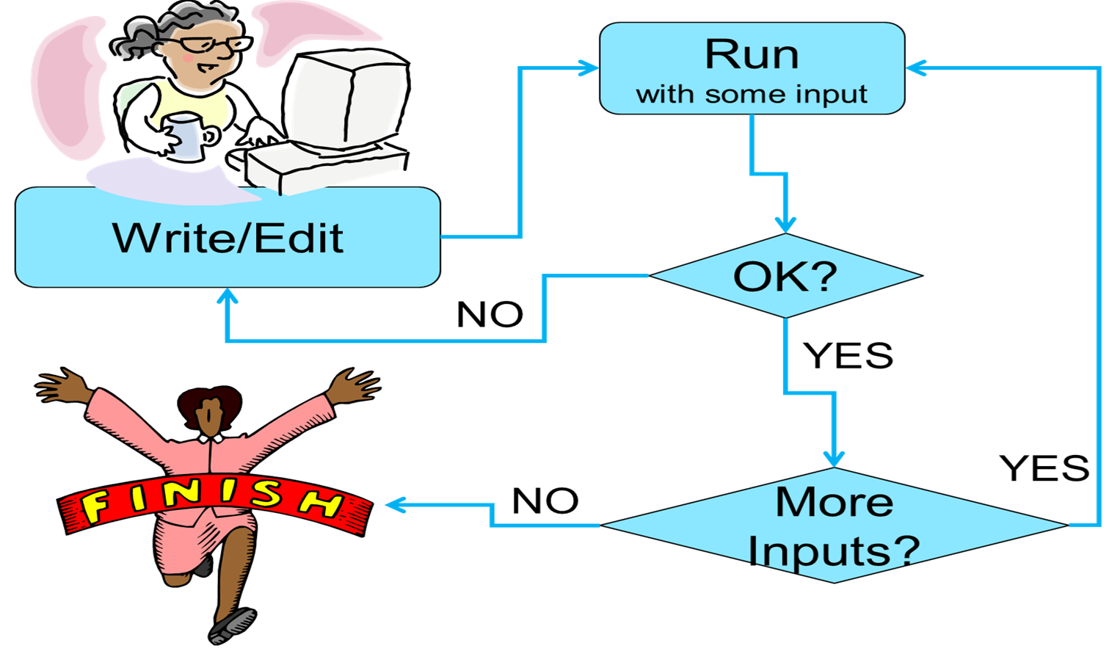
Python programming

Slide 17
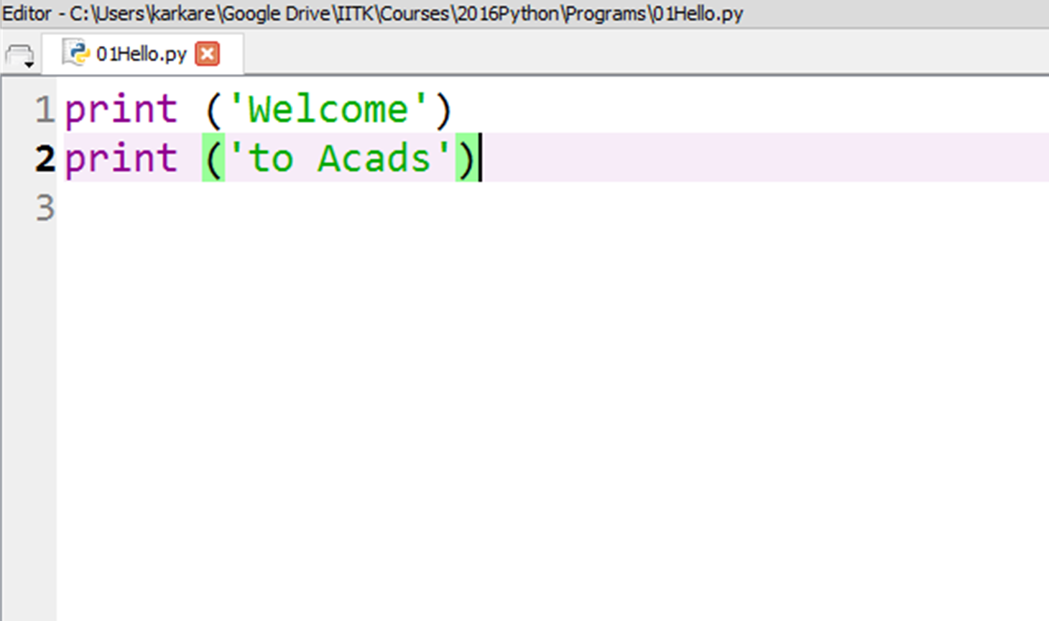
Output command in Python - Print
Purpose: Displays output on the screen.
Usage: Commonly used for debugging or showing results to the user
Accepts multiple arguments and allows formatted output

Slide 18
Output command in Python - Print
# 1. Basic Printing
print("Hello, World!")
# 2. Printing Variables
name = "Alice"
age = 25
print("Name:", name, "Age:", age)
# 3. Using `sep` Parameter
print("Python", "is", "fun", sep="-")
# 4. Using `end` Parameter
print("Hello", end=" ")
print("World!")
# 5. Formatted Strings (f-strings)
print(f"My name is {name} and I am {age} years old.")
# 6. Printing in Multiple Lines
print("Line 1\nLine 2\nLine 3")
# 7. Printing Special Characters
print("Tab\tSpace\nNew Line")
# 8. Concatenating Strings
part1 = "Hello"
part2 = "World"
print(part1 + " " + part2 + "!")
# 9. Printing a List
fruits = ["apple", "banana", "cherry"]
print("Fruits:", fruits)
# 10. Printing a Dictionary
person = {"name": "Alice", "age": 25}
print("Person details:", person)
# 11. Printing with File Output
with open("output.txt", "w") as file:
print("This is written to a file.", file=file)
# 12. Printing Unicode Characters
print("\u2764\uFE0F") # Heart symbol
# 13. Printing Repeated Characters
print("*" * 10)
# 14. Suppressing the Newline
print("Hello", end="")
print("World!")
# 15. Printing in Hexadecimal, Octal, and Binary
num = 255
print(f"Hexadecimal: {num:x}")
print(f"Octal: {num:o}")
print(f"Binary: {num:b}")
# 16. Using Escape Characters
print("He said, \"Python is awesome!\"")
# 17. Printing Raw Strings
print(r"C:\Users\Alice\Documents")
# 18. Multiline Printing
print("""
This is line 1
This is line 2
This is line 3
""")
# 19. Dynamic Printing Inside Loops
for i in range(1, 4):
print(f"Counting: {i}")
# 20. Printing with Conditional Logic
x = 10
print("Positive" if x > 0 else "Non-positive")

Slide 19
Input command in Python - Input
What: It is a built-in method used to take user input from the console.
Purpose: To read a line of text entered by the user and return it as a string.
Use: It allows programs to interact with users by prompting them for data, which can then be processed within the program.
String conversion: Regardless of what type of data the user enters (text, numbers, etc.), the input() function always returns the input as a string.
Caution: If you need to perform numerical operations on the input, you must convert it to an appropriate type (e.g., integer or float).

Slide 20
Input command in Python - Input
# 1. Basic Input
name = input("Enter your name: ")
print(f"Hello, {name}!")
# 2. Converting Input to Integer
age = input("Enter your age: ")
age = int(age) # Convert to integer
print(f"You are {age} years old.")
# 3. Converting Input to Float
height = input("Enter your height in meters: ")
height = float(height) # Convert to float
print(f"Your height is {height} meters.")
# 4. Boolean Input
is_student = input("Are you a student? (yes/no): ").lower() == "yes"
print(f"Student status: {is_student}")
# 5. Taking Multiple Inputs
x, y = input("Enter two numbers separated by space: ").split()
x, y = int(x), int(y) # Convert both inputs to integers
print(f"Sum of {x} and {y} is {x + y}.")
# 6. Input Validation
age = input("Enter your age: ")
if age.isdigit():
age = int(age)
print(f"You are {age} years old.")
else:
print("Invalid input! Please enter a number.")
# 7. Handling Inputs in a Loop
while True:
number = input("Enter a positive number: ")
if number.isdigit() and int(number) > 0:
number = int(number)
break
print("Invalid input. Try again!")
print(f"You entered: {number}")
# 8. Using Input in a Decision-Making Scenario
score = int(input("Enter your score: "))
if score >= 90:
grade = "A"
elif score >= 80:
grade = "B"
elif score >= 70:
grade = "C"
else:
grade = "F"
print(f"Your grade is {grade}.")
# 9. Taking a List as Input
numbers = input("Enter a list of numbers separated by commas: ").split(',')
numbers = [int(num) for num in numbers] # Convert each input to integer
print(f"You entered the numbers: {numbers}")
# 10. Advanced Use Case: Calculator
num1 = float(input("Enter the first number: "))
num2 = float(input("Enter the second number: "))
operation = input("Enter operation (+, -, *, /): ")
if operation == "+":
result = num1 + num2
elif operation == "-":
result = num1 - num2
elif operation == "*":
result = num1 * num2
elif operation == "/":
result = num1 / num2 if num2 != 0 else "undefined (division by zero)"
else:
result = "Invalid operation!"
print(f"The result is: {result}")

Slide 21
Python - Literals
Literals are constant values assigned to variables or used directly in a program
String Literal: A sequence of characters enclosed in single ('), double ("), triple (''' or """) quotes. Types: Single-line Strings and Multi-line Strings
Numeric Literals: Represent numbers in the program. Types: Integer, Float, Decimal, Complex
Boolean Literals: Represent True or False values. Usage: In conditional statements.
Special Literal: Represents the absence of a value using None.
Literal Collections: Represent data structures like lists, tuples, dictionaries, and sets.
Numeric Literals with Base: Represent numbers in different bases. Types: Binary, Octal, Hexadecimal.
String Literals with Escape Sequences: Special characters represented by a backslash (\).
Raw String Literals: Treats backslashes as literal characters instead of escape sequences.
Unicode Strings: Represent Unicode characters

Slide 22
Python - Literals
# String Literals
single_line = "Hello"
multi_line = '''This is a
multi-line string.'''
# Numeric Literals
integer = 42
floating_point = 3.14
complex_num = 5 + 2j
# Boolean Literals
is_active = True
# Special Literal
no_value = None
# Collection Literals
fruits = ['apple', 'banana']
coordinates = (10, 20)
person = {'name': 'Alice', 'age': 25}
unique_numbers = {1, 2, 3}
# Numeric Literals with Base
binary = 0b1010
octal = 0o12
hexadecimal = 0x1A
# Escape Sequences and Raw Strings
escaped = "Hello\nWorld"
raw_string = r"C:\Path\to\File"

Slide 23
Python - Constants
Constants are variables that hold values which are not meant to change during the program's execution.
Python does not have built-in support for constants (like const in Java)
Use naming conventions to signify constants - “Uppercase” with underscores to declare constants, and developers are expected to avoid modifying them.
Constants improve code clarity, maintainability, and avoid hardcoding values. (MAX_VALUE, PI).
Tools like final or custom classes can help enforce constant-like behaviour in Python.
Types: Mathematical, Physical, Application-Specific and 3rd party Constants

Slide 24
Python - Constants
# 1. Mathematical Constants
PI = 3.14159 # Approximation of Pi
EULER_NUMBER = 2.71828 # Base of the natural logarithm
# 2. Physical Constants
SPEED_OF_LIGHT = 299792458 # in meters/second
GRAVITY = 9.8 # in m/s^2
# 3. Application-Specific Constants
MAX_LOGIN_ATTEMPTS = 3
API_URL = "https://example.com/api"
DATABASE_NAME = "my_database"
# Example Usage of Constants
# Area of a Circle
radius = 5
area = PI * radius**2
print(f"Area of the circle with radius {radius}: {area:.2f}")
# Force Due to Gravity
weight = 70 # in kg
force = weight * GRAVITY
print(f"Force on an object of weight {weight} kg: {force:.2f} N")
# Handling Application-Specific Constants
print(f"Max Login Attempts:
{MAX_LOGIN_ATTEMPTS}")
print(f"API Endpoint: {API_URL}")
print(f"Database Name: {DATABASE_NAME}")
# Enforcing Constants (Using `Final` from `typing`)
from typing import Final
# Declaring constants with `Final`
FINAL_PI: Final = 3.14159 # Value should not change
try:
FINAL_PI = 3.14 # This will raise a warning in static type checkers like MyPy
except Exception as e:
print("Attempt to change FINAL_PI failed:", e)
# Enforcing Constants (Using a Custom Class)
class Constants:
PI = 3.14159
GRAVITY = 9.8
SPEED_OF_LIGHT = 299792458
# Access constants from the class
print(f"Constant PI from class: {Constants.PI}")
print(f"Speed of Light: {Constants.SPEED_OF_LIGHT} m/s")
# Attempt to Change Constant in the Class
try:
Constants.PI = 3.14 # Python allows it but should be avoided by convention
print("Constants.PI has been changed (discouraged):", Constants.PI)
except AttributeError as e:
print("Failed to change Constants.PI:", e)

Slide 25
Python - Identifiers
Identifiers are names used to identify variables, functions, classes, etc.
They are fundamental building blocks of any Python program.
Identifier naming rules: no special characters, no reserved keywords, case-sensitive, and cannot start with digits.
Identifiers can include letters (a-z, A-Z), digits (0-9), and underscores (_).
Identifiers cannot start with a digit.
Identifiers are case-sensitive.
Identifiers cannot use Python's reserved keywords.
Identifiers cannot contain special characters.

Slide 26
Naming Conventions for Identifiers
Identifier naming conventions include snake_case, camelCase, PascalCase all All Caps.
Snake Case: Use underscores to separate words.
Example: my_variable, max_value
Camel Case: Capitalize the first letter of each word except the first.
Example: myVariable, maxValue
Pascal Case: Capitalize the first letter of all words.
Example: MyVariable, MaxValue
All Caps: Use for constants.
Example: PI, MAX_LIMIT

Slide 27
Python - Identifiers
# Valid Identifiers
name = "Alice"
age = 25
is_active = True
_max_value = 100
data123 = [1, 2, 3]
# Invalid Identifiers (Uncomment to see errors)
# 2data = "Invalid" # Starts with a digit
# my-name = "Invalid" # Contains hyphen
# class = 10 # Reserved keyword
# Function with Identifier
def calculate_square(number):
return number ** 2
result = calculate_square(5)
print(f"The square of 5 is {result}")
# Class with Identifier
class User:
def __init__(self, name, age):
self.name = name
self.age = age
user1 = User("Alice", 30)
print(f"User: {user1.name}, Age: {user1.age}")

Slide 28
Python - Variables
A variable is a reserved memory location that can be used to store values, that can be referenced and manipulated in a program.
They are dynamically typed, case-sensitive, and do not require explicit declaration.
Assignment: Variables can be used for single or multiple or Swap assignment
Local Variable: Declared inside a function and accessible only within that function.
Global Variable: Declared outside a function and accessible throughout the program.
Types: Numeric, Text, Boolean, and Collection (list, tuple, set, dict)
Naming Convention:
Variable names must begin with a letter (a-z, A-Z) or an underscore (_).
After the first character, the name can have letters, digits, or underscores.
Avoid characters like @, $, #, etc.
Cannot Use Reserved Keywords: Keywords like if, else, class, def, etc., cannot be used as variable names.

Slide 29
Python - Variables
# Variable Assignment
x = 10
y = x + 3.14
name = "Alice“
Print(id(x))
# Multiple Assignment
a, b, c = 1, 2, 3
print(a, b, c)
x = y = z = “apple”
print(x, y, z)
# Swapping Variables
a=1
b=2
a, b = b, a
print("Swapped:", a, b)
# Using Different Types
is_valid = True
fruits = ["apple", "banana", "cherry"]
# Global vs Local Variables
x = "Global"
def test():
local_var = "Local"
global x
x = "Modified Global"
print(local_var)
print(x)
test()
print(x) # Global variable after modification
# Constants
PI = 3.14159
GRAVITY = 9.8
print("PI:", PI, "Gravity:", GRAVITY)

Slide 30
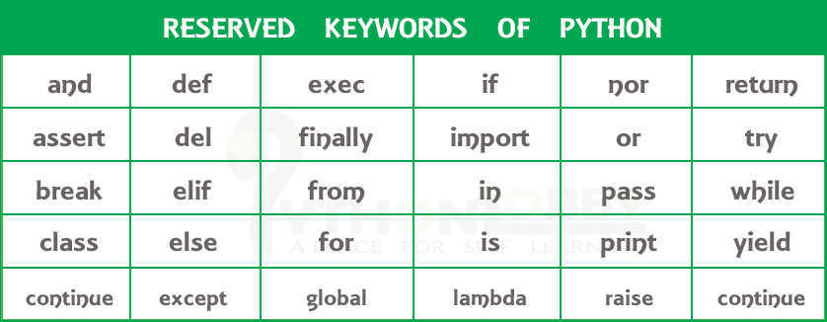
Python Keywords

Slide 31
Python –Key words or Reserved words
False Boolean value representing falsehood.
True Boolean value representing truth.
None Represents the absence of a value.
and Logical AND operator.
or Logical OR operator.
not Logical NOT operator.
if Starts a conditional statement.
elif Else if in conditional statements.
else Defines the else block in a conditional.
for Starts a for loop.
while Starts a while loop.
break Exits the nearest enclosing loop.
continue Skips the rest of the loop iteration.
in Checks membership in collections or loops over items.
is Tests object identity.
def Defines a function.
class Defines a class.
return Returns a value from a function.
yield Produces a generator object.
try Starts a try block for exception handling
except Defines exception handling code.
finally Executes code after try or except.
raise Raises an exception.
import Imports a module.
from Specifies the source of imports.
as Alias for imported modules or variables.
assert Debugging tool to test conditions.
global Declares a variable as global.
nonlocal Declares a variable as nonlocal.
pass Does nothing; used as a placeholder.
lambda Creates an anonymous function.
with handle exception or manage resources
del Deletes objects or variables.
async Declares an asynchronous function.
await Waits for asynchronous call to complete

Slide 32
Python Suite
Python Suite refers to a group of individual statements that make up a block of code.
Python uses indentation (whitespace) to define the boundaries of a suite, as opposed to other programming languages that use braces ({}) or keywords like begin and end.
All statements in a suite must be indented by the same amount.
Suites Belong to Constructs: Suites are used with constructs like if, for, while, def, class, try, and others, to determine the suite's purpose and execution.
Colon (:):A suite begins with a colon (:) at the end of the header line of a construct.
Single vs Multiple Statements: A suite can consist of a single statement or multiple statements indented to the same level.

Slide 33
Python Suite
# Single Statement Suite
if True:
print("Condition is True")
# Multi-line Suite
if True:
print("Condition is True")
print("This is part of the suite")else:
print("Condition is False")

Slide 34
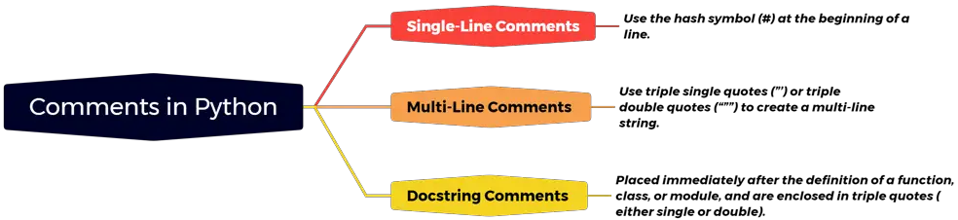
Python Comments
Comments are non-executable statements that are ignored by the Python interpreter during execution and serve as documentation to explain code.
Single-Line Comments: Use # for inline or single-line notes, for brief explanations or notes about a single line of code.
Multi-Line Comments: Use consecutive # or triple quotes for multiple lines, for documenting a block of code.
Docstrings: Use for documenting functions, classes, and modules.

Slide 35
Python Comments
# ---------------------------------
# Demonstrating Comments in Python
# ---------------------------------
# 1. Single-Line Comments
# This is a single-line comment explaining the next line of code
x = 10 # Assigning the value 10 to variable x
# Another example of single-line comment
y = 20 # Assigning the value 20 to variable y
# Performing addition
sum_value = x + y # Sum of x and y
print(f"Sum: {sum_value}")
# ---------------------------------
# 2. Multi-Line Comments using #
# This section demonstrates
# multi-line comments using multiple # symbols.
# Each line starts with a #.
# Calculating the product of two numbers
product = x * y # Multiply x and y
print(f"Product: {product}")
# ---------------------------------
# 3. Multi-Line Comments using Triple Quotes
"""
This section demonstrates multi-line comments
using triple quotes. These are often used as
block comments or temporary code.
"""
# Calculating the square of a number
square = x ** 2
print(f"Square of {x}: {square}")
# ---------------------------------
# 4. Docstrings for Functions
def factorial(n):
"""
Calculates the factorial of a number recursively.
:param n: Non-negative integer
:return: Factorial of n
"""
# Base case: Factorial of 0 or 1 is 1
if n == 0 or n == 1:
return 1
# Recursive case
return n * factorial(n - 1)
# Example usage of the factorial function
num = 5 # Number for which factorial is to be calculated
print(f"Factorial of {num}: {factorial(num)}")
# ---------------------------------
# 5. Inline Comments
# Defining constants
PI = 3.14159 # Approximation of Pi
radius = 7 # Radius of the circle
# Calculating area of the circle
area = PI * radius**2 # Area formula: πr²
print(f"Area of the circle: {area}")
# ---------------------------------
# 6. Using Comments in Loops
# Printing numbers using a loop
for i in range(1, 6): # Loop from 1 to 5
print(f"Number: {i}") # Inline comment to explain the output
# ---------------------------------
# 7. Commenting Out Code
# Uncomment the following lines to enable subtraction and division
# difference = x - y
# print(f"Difference: {difference}")
# quotient = x / y
# print(f"Quotient: {quotient}")
# ---------------------------------
# End of Script
# ---------------------------------

Slide 36
Python Statements
A statement in Python is a single line of code that performs an action.
Python statements are the building blocks of any Python program.
Types:
Expression Statements include operations, function calls, or assignments to perform a computation or evaluate an expression.
Assignment Statements assign values to variables using the = operator.
Conditional Statements execute specific blocks of code based on conditions (if, elif, else)
Looping Statements execute a block of code repeatedly (for, while).
Control Flow Statements alter the normal flow of execution (break, continue, pass).
Import Statements import modules or specific functions from modules.(import)
Function and Class Definition Statements Define functions or classes using (def or class).
Exception Handling Statements Handle errors using try, except, and finally.

Slide 37
Python Statements
# 1. Expression Statements
x = 5 + 10 # Assignment with expression
print(x) # Print statement
# 2. Assignment Statements
name = "Alice"
age = 25
# 3. Conditional Statements
if age > 18:
print("Adult")
else:
print("Minor")
# 4. Looping Statements
for i in range(3): # For loop
print(f"Loop iteration: {i}")
count = 0
while count < 3: # While loop
print(f"While count: {count}")
count += 1
# 5. Control Flow Statements
for i in range(5):
if i == 3:
continue # Skip iteration when i is 3
print(i)
# 6. Import Statements
import math
print(f"Square root of 16: {math.sqrt(16)}")
# 7. Function Definition Statement
def greet(name):
print(f"Hello, {name}!")
greet("Alice")
# 8. Class Definition Statement
class Person:
def __init__(self, name, age):
self.name = name
self.age = age
def display(self):
print(f"Name: {self.name}, Age: {self.age}")
person1 = Person("Alice", 25)
person1.display()
# 9. Exception Handling Statements
try:
result = 10 / 0
except ZeroDivisionError:
print("Cannot divide by zero.")
finally:
print("This block always executes.")

Slide 38
Python Expressions
An expression in Python is a combination of values, variables, operators, and function calls that Python evaluates to produce a value.
Expressions are the core components of assignment or conditional statements.
Every expression produces a value (e.g., 5 + 3 evaluates to 8).
Complex expressions can be formed by combining simpler ones.
Arithmetic Expressions combine numbers, variables, and arithmetic operators (+, -, *, /, //, %, **).
Relational/Comparison Expressions compare values using comparison operators (==, !=, <, >, <=, >=)
Logical Expressions combine boolean values and expressions using logical operators (and, or, not).
String Expressions combine strings using operators like + (concatenation) or * (repetition).
Conditional Expressions (Ternary Operator) evaluate a value based on a condition in a single line.
Function Call Expressions use a function to evaluate and return a value.
List and Dictionary Expressions create or access data structures.
Generator Expressions generate values lazily using a concise syntax.

Slide 39
Python Expressions
# 1. Arithmetic Expressions
a = 10
b = 5
c = a + b # Addition
d = a * b # Multiplication
print(f"Arithmetic Results: {c}, {d}")
# 2. Relational/Comparison Expressions
print(f"Is a > b? {a > b}")
print(f"Is a == b? {a == b}")
# 3. Logical Expressions
print(f"Logical AND: {a > b and b > 0}")
print(f"Logical NOT: {not (a < b)}")
# 4. String Expressions
greeting = "Hello"
name = "Alice"
print(f"String Concatenation: {greeting + ' ' + name}")
print(f"String Repetition: {greeting * 3}")
# 5. Conditional (Ternary) Expressions
x, y = 15, 20
max_value = x if x > y else y
print(f"Max Value: {max_value}")
# 6. Function Call Expressions
def square(num):
return num ** 2
print(f"Square of 4: {square(4)}")
# 7. List and Dictionary Expressions
fruits = ["apple", "banana", "cherry"]
print(f"Second fruit: {fruits[1]}")
details = {"name": "Alice", "age": 25}
print(f"Name from dictionary: {details['name']}")
# 8. Generator Expressions
squares = (x ** 2 for x in range(5))
print(f"First two squares: {next(squares)}, {next(squares)}")

Slide 40
Python Blocks and Indentions
Blocks in Python are groups of statements that are intended to be executed together. (function, loop, conditional statement, class definition)
Python relies on indentation (whitespace at the beginning of a line) to define these blocks, instead of braces ({}) used in many other programming languages.
Blocks begin after a statement that ends with a colon (:) and are indented relative to the containing structure.
Indentation is usually spaces or tabs at the beginning of a line.
It defines the hierarchical structure of the code and groups multiple lines into a block.
Consistent Indentation: Use the same number of spaces (or tabs) for all lines in a block. Python recommends 4 spaces per indentation level.
Mandatory Indentation: Indentation is not optional in Python. Improper indentation will raise an Indentation Error.
Nested Blocks: Sub-blocks (e.g., a loop inside an if statement) must have additional indentation.

Slide 41
Python Blocks and Indentions
# ---------------------------------
# Demonstrating Python Blocks and Indentation
# ---------------------------------
# 1. Conditional Statements Block
x = 10
if x > 5: # Block starts here
print("x is greater than 5") # Part of the 'if' block
print("This is part of the same block")
else:
print("x is 5 or less") # Block for 'else'
# 2. Loop Blocks
print("\nLoop Example:")
for i in range(3): # Block starts for the loop
print(f"Iteration {i}") # Inside the loop block
if i == 2: # Nested block
print("This is inside a nested block")
# 3. Function Block
def greet(name):
print(f"Hello, {name}") # Part of the function block
print("Welcome to Python!") # Same block
print("\nFunction Example:")
greet("Alice")
# 4. Class Definition Block
class MyClass:
def __init__(self, value): # Constructor block
self.value = value
def display(self): # Method block
print(f"Value: {self.value}")
print("\nClass Example:")
obj = MyClass(42)
obj.display()
# 5. Nested Blocks Example
print("\nNested Blocks Example:")
if x > 0: # Outer block
print("x is positive")
for i in range(3): # Loop block
if i % 2 == 0: # Nested block inside the loop
print(f"{i} is even")
# 6. Improper Indentation (Commented Out to Avoid Error)
# Uncomment the following block to see errors caused by improper indentation.
# if True:
# print("This will raise an error") # Missing indentation
# if True:
# print("Correct indentation")
# print("This will cause an error") # Mixing spaces and tabs
# ---------------------------------
# End of Script
# ---------------------------------

Slide 42
Python – Data types
In Python, data types represent the type of data stored in a variable.
Python provides a variety of built-in data types to represent different kinds of data.
Each data type has unique properties and operations.
Use appropriate data types based on the requirements of your program for efficient and readable code.
Numeric Data Types: Integer (int),Floating-point (float), Complex numbers (complex) Strings (str), Booleans (bool)
Sequence Data Types: List (list), Tuple (tuple), Range (range)
Set Data Types: Set (set), Frozen Set (frozenset)
Mapping Data Types: Dictionary (dict)
Binary Data Types: Bytes (bytes),Bytearray (bytearray),Memoryview (memoryview)
None Type: NoneType (represents the absence of a value)

Slide 43
Python – Data types
# Numeric Data Types
integer_num = 10 # int
float_num = 3.14 # float
complex_num = 2 + 3j # complex
print(f"Integer: {integer_num}, Float: {float_num}, Complex: {complex_num}")
# Boolean
is_active = True
print(f"Boolean: {is_active}")
# String
message = "Hello, Python!“ #str
print(f"String: {message}")
# List
fruits = ["apple", "banana", "cherry"]
print(f"List: {fruits}")
# Tuple
coordinates = (10, 20, 30)
print(f"Tuple: {coordinates}")
# Range
numbers = range(1, 5)
print(f"Range: {list(numbers)}") # Convert to list for display
# Set
unique_numbers = {1, 2, 3, 4}
print(f"Set: {unique_numbers}")
# Frozen Set
frozen_set = frozenset(["a", "b", "c"])
print(f"Frozen Set: {frozen_set}")
# Dictionary
person = {"name": "Alice", "age": 25}
print(f"Dictionary: {person}")
# Binary Data Types
byte_data = b"Hello" # bytes
bytearray_data = bytearray(b"World") # bytearray
memory_view = memoryview(byte_data) # memoryview
print(f"Bytes: {byte_data}, Bytearray: {bytearray_data}, Memoryview: {memory_view.tobytes()}")
# None Type
nothing = None
print(f"None Type: {nothing}")

Slide 44
Python Data Conversion
Python provides methods for type conversion, which allow you to convert one data type to another.
Implicit Type Conversion: Automatically handled by Python (e.g., int to float), converts a smaller data type to a larger data type when performing operations.
Example: Converting an integer to a float during arithmetic operations.
Explicit Type Conversion (Type Casting): Done manually by the programmer using Python’s built-in functions like int(), float(), str(), etc.
Best Practices: Use try-except for error-prone conversions.

Slide 45
Python Data Conversion
# Implicit Conversion
a = 5
b = 2.5
result = a + b # int + float = float
print(f"Result: {result}, Type: {type(result)}")
# Explicit Conversion
# String to Integer
num_str = "100"
num_int = int(num_str)
print(f"Converted to Integer: {num_int}, Type: {type(num_int)}")
# Float to Integer
num_float = 3.75
num_int = int(num_float)
print(f"Converted to Integer (truncated): {num_int}")
# List to Tuple
fruits = ["apple", "banana", "cherry"]
fruits_tuple = tuple(fruits)
print(f"List to Tuple: {fruits_tuple}")
# Tuple to List
fruits_list = list(fruits_tuple)
print(f"Tuple to List: {fruits_list}")
# List to Set
numbers = [1, 2, 2, 3, 4]
unique_numbers = set(numbers)
print(f"List to Set (unique values): {unique_numbers}")
# Dictionary Conversion
pairs = [("name", "Alice"), ("age", 30)]
person = dict(pairs)
print(f"List of Pairs to Dictionary: {person}")
# Error Handling
try:
invalid_num = int("Hello")
except ValueError:
print("Invalid conversion attempted!")

Slide 46
Python Operators
Operators in Python are special symbols or keywords used to perform operations on variables and values.
They are categorized based on their functionality.
Arithmetic Operators for mathematical operations.
Comparison (Relational) Operators to compare two values and return a boolean result.
Logical Operators to combine conditional statements.
Bitwise Operators to perform bit-level operations.
Assignment Operators to assign values to variables.
Membership Operators to check if a value is a member of a sequence.
Identity Operators to compare memory locations of two objects.

Slide 47
Python Operators
# Arithmetic Operators
x, y = 10, 3
print(x + y, x - y, x * y, x / y, x // y, x % y, x ** y)
# Comparison Operators
print(x == y, x != y, x > y, x < y, x >= y, x <= y)
# Logical Operators
print(x > 5 and y < 5, x > 15 or y < 5, not (x > 5))
# Bitwise Operators
print(x & y, x | y, x ^ y, ~x, x << 1, x >> 1)
# Assignment Operators
x = 5
print(x)
x += 3
print(x)
# Membership Operators
fruits = ["apple", "banana"]
print("apple" in fruits, "grape" not in fruits)
# Identity Operators
a = [1, 2, 3]
b = a
c = [1, 2, 3]
print(a is b, a is not c, a == c)

Slide 48
Case Study
Write a simple program for a restaurant that takes orders and prints out a receipt
Components of the Restaurant program:
Menu Definition: A dictionary menu contains menu items and their prices.
Order Input: Users input the item name and quantity. Input is validated to ensure the item exists in the menu.
Receipt generation: The program calculates the total cost for each item and the overall total.
Receipt display: A formatted receipt is printed at the end.

Slide 49
# Restaurant Menu
menu = {
"Burger": 5.99,
"Pizza": 8.99,
"Pasta": 7.49,
"Salad": 4.99,
"Soda": 1.99,
"Coffee": 2.49
}
# Welcome message
print("Welcome to the Python Cafe!")
print("Here is our menu:\n")
# Display the menu
for item, price in menu.items():
print(f"{item}: ${price:.2f}")
# Taking orders
order = {}
print("\nPlease place your order (type 'done' when finished):")
while True:
item = input("Enter item name: ").strip()
if item.lower() == 'done':
break
elif item in menu:
quantity = int(input(f"How many {item}(s) would you like? "))
if item in order:
order[item] += quantity
else:
order[item] = quantity
else:
print("Sorry, we don't have that item. Please choose from the menu.")
# Calculate total
print("\n--- Receipt ---")
total = 0.0
for item, quantity in order.items():
item_total = menu[item] * quantity
total += item_total
print(f"{item} x{quantity} - ${item_total:.2f}")
# Display total
print("----------------")
print(f"Total: ${total:.2f}")
print("Thank you for dining with us!")

Slide 50
IDLE
>>> 1 + 2
>>> 8 - 2
>>>12 * 12
>>> 82/4
>>>3**3
>>>“Hello, World!”
>>>print(“Hello, World!”)
>>>exit()
>>>quit()
>>>sys.exit()
>>> dir()
>>>help()
>>> a = 10
>>> b = 0
>>> a / b
>>> (10 > 5) and (3 < 8)
>>> import math
>>> math.sqrt(16)
>>> import os
os.mkdir(“newdir”)
>>> def greet(name):
... return f"Hello, {name}!“
...>>> greet("Alice")

